Slide 1
ANALYZING WEB-STATS
Machine Learning
using
Python
Ankit

Slide 2
INTRODUCTION

Slide 3
Python
HLL , Interpreted , Multi-paradigm programming language.
Supports multiple free libraries.
Supports indentation.
Flexible
Mixable (C+Python , Java+Python , R+Python etc.)
Inbuilt libraries written in C/C++.
Created by Guiddo Van Rossum
Easy syntax (similar to English language)

Slide 4
Python Libraries :
Numpy
Pandas
Matplotlib
Scipy
Scikit

Slide 5
Machine Learning :
Machine learning teaches machines to learn to carry out tasks by themselvesMachine learning teaches machines to learn to carry out tasks by themselves.
The goal of machine learning is to teach machines (software) to carry out tasks by providing them a couple of examples (how to do or not do the task).
Machine learning (often also referred to as Data Mining or Predictive Analysis).

Slide 6
APPROACH
AND
WORKING

Slide 7
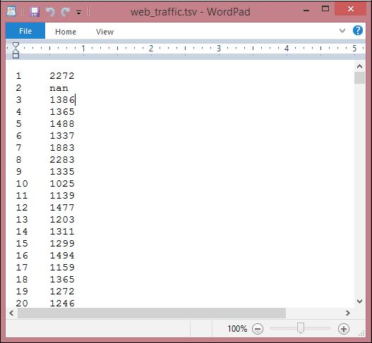
Reading in the data :
•import scipy as sp
•data = sp.genfromtxt("web_traffic.tsv", delimiter="\t")

Slide 8
Preprocessing and cleaning the data :
x = data[:,0]
y = data[:,1]
x = x[~sp.isnan(y)]
y = y[~sp.isnan(y)]
#removed the fake data or incomplete data

Slide 9
Plotting the graph :
import matplotlib.pyplot as plt
# plot the (x,y) points with dots of size 10
plt.scatter(x, y, s=10)
plt.title("Web traffic over the last month")
plt.xlabel("Time")
plt.ylabel("Hits/hour")
plt.xticks([w*7*24 for w in range(10)], ['week %i' % w for w in range(10)])
plt.autoscale(tight=True)
# draw a slightly opaque, dashed grid
plt.grid(True, linestyle='-', color='0.75')
plt.show()

Slide 10
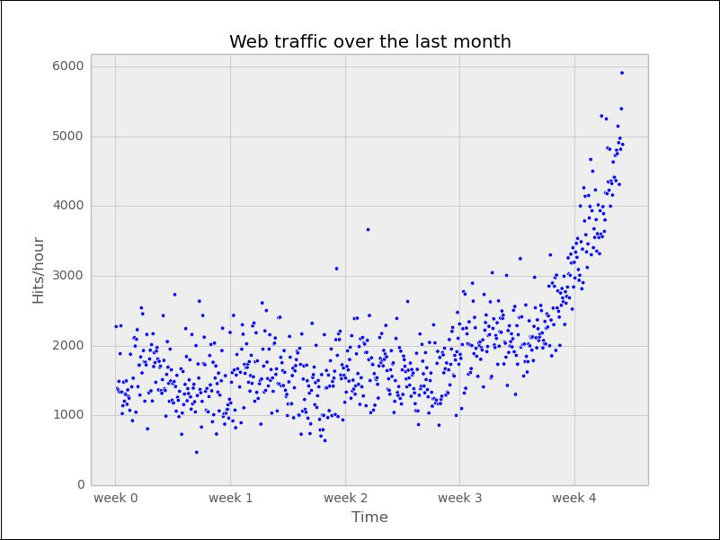
Graph :

Slide 11
Choosing the right model and learning algorithm :
Now that we have a first impression of the data, we return to the initial question: How long will our server handle the incoming web traffic? To answer this we have to do the following:
1) Find the real model behind the noisy data points.
2) Following this, use the model to extrapolate into the future to find the point in time where our infrastructure has to be extended.

Slide 12
Before building our first model…
def error(f, x, y):
return sp.sum((f(x)-y)**2)
# defines an error function to calculate L2 loss.

Slide 13
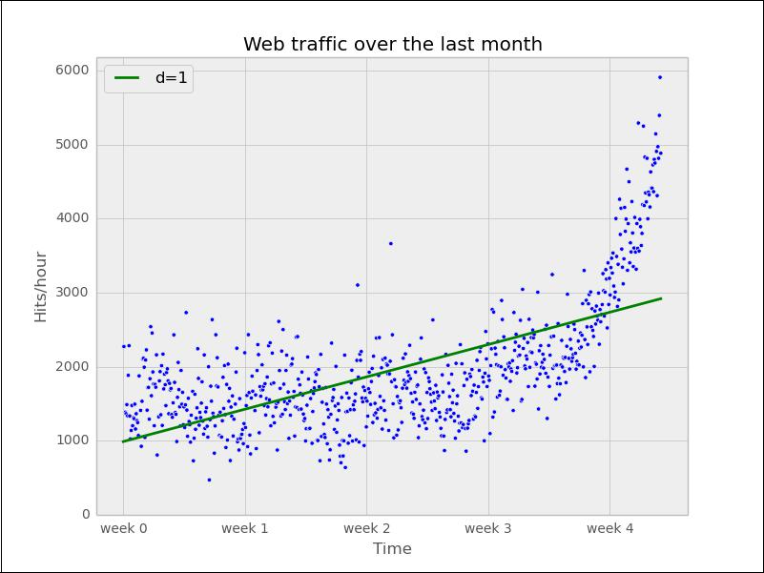
Starting up with a straight line :
fp1, residuals, rank, sv, rcond = sp.polyfit(x, y, 1, full=True)
fx = sp.linspace(0,x[-1], 1000) # generate X-values for plotting
plt.plot(fx, f1(fx), linewidth=4)

Slide 14

Towards some advanced stuff :
Let's now fit a more complex model, a polynomial of degree 2, to see whether it better understands our data:
f2p = sp.polyfit(x, y, 2)
f2 = sp.poly1d(f2p)

Slide 15
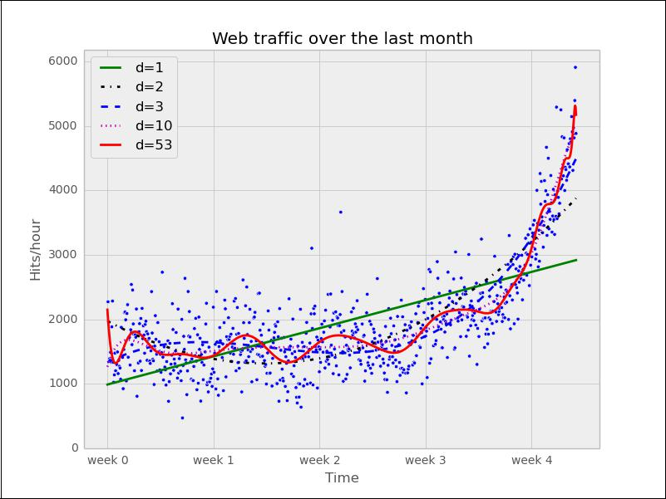
Increasig the dimension :
Error d=1: 317,389,767.339778
Error d=2: 179,983,507.878179
Error d=3: 139,350,144.031725
Error d=10: 121,942,326.363461
Error d=53: 109,318,004.475556

Slide 16
Overfitting :
However, taking a closer look at the fitted curves, we start to wonder whether they also capture the true process that generated that data. Framed differently, do our models correctly represent the underlying mass behavior of customers visiting our website? Looking at the polynomial of degree 10 and 53, we see wildly oscillating behavior. It seems that the models are fitted too much to the data. So much that it is now capturing not only the underlying process but also the noise. This is called overfitting.

Slide 17
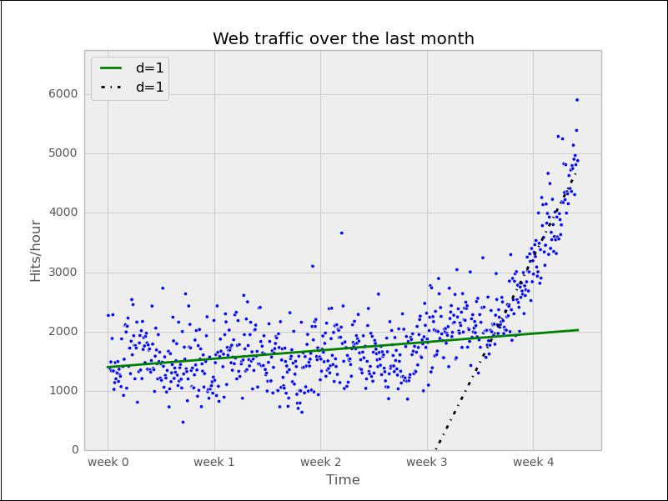
Stepping back to go forward – another look at our data
So, we step back and take another look at the data. It seems that there is an inflection point between weeks 3 and 4. So let's separate the data and train two lines using week 3.5 as a separation point:
inflection = 3.5*7*24 # calculate the inflection point in hours
xa = x[:inflection] # data before the inflection point
ya = y[:inflection]
xb = x[inflection:] # data after
yb = y[inflection:]
fa = sp.poly1d(sp.polyfit(xa, ya, 1))
fb = sp.poly1d(sp.polyfit(xb, yb, 1))
fa_error = error(fa, xa, ya)
fb_error = error(fb, xb, yb)
print("Error inflection=%f" % (fa_error + fb_error))
Error inflection=132950348.197616

Slide 18
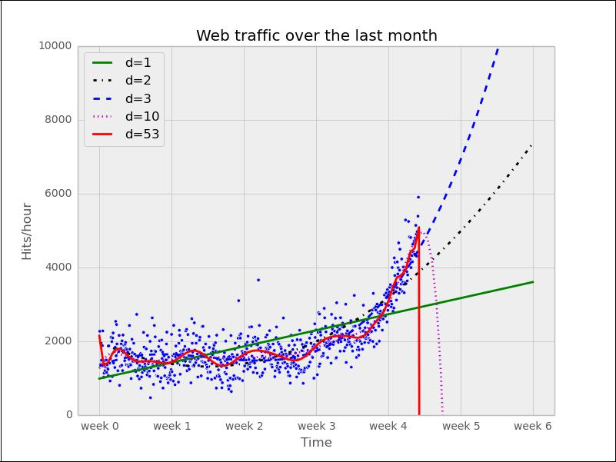
Analyzing future :
Clearly, the combination of these two lines seems to be a much better fit to the data than anything we have modeled before. But still, the combined error is higher than the higher order polynomials. Can we trust the error at the end?

Slide 19
Underfitting :
The models of degree 10 and 53 don't seem to expect a bright future of our start-up. They tried so hard to model the given data correctly that they are clearly useless to extrapolate beyond. This is called overfitting. On the other hand, the lower degree models seem not to be capable of capturing the data good enough. This is called underfitting.

Slide 20
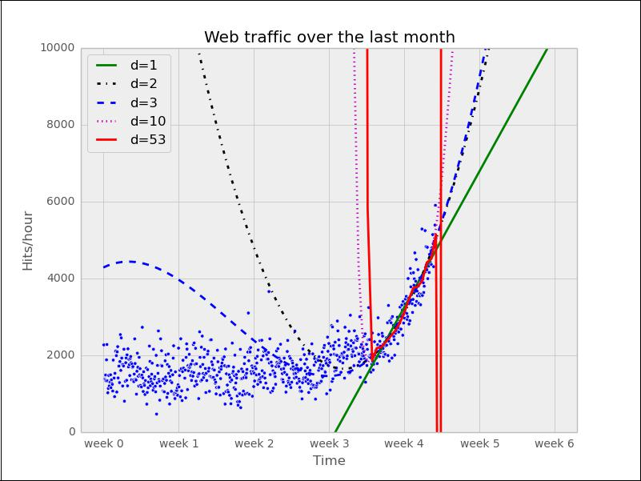
Checking the last week :
So let's play fair to models of degree 2 and above and try out how they behave if we fit them only to the data of the last week. After all, we believe that the last week says more about the future than the data prior to it. The result can be seen in the following psychedelic chart, which further shows how badly the problem of overfitting is.

Slide 21
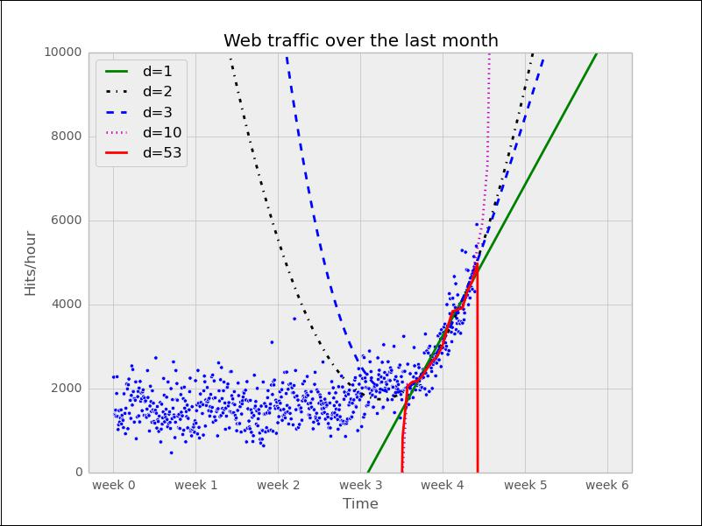
Training and Testing :
As the model has been trained not knowing the held-out data, we should get a more realistic picture of how the model will behave in the future.
The test errors for the models trained only on the time after inflection point now show a completely different picture:
Error d=1: 6397694.386394
Error d=2: 6010775.401243
Error d=3: 6047678.658525
Error d=10: 7037551.009519
Error d=53: 7052400.001761

Slide 22
Result and Discussion
Finally we have arrived at a model which we think represents the underlying process best; it is now a simple task of finding out when our infrastructure will reach 100,000 requests per hour. We have to calculate when our model function reaches the value 100,000.
Having a polynomial of degree 2, we could simply compute the inverse of the function and calculate its value at 100,000. Of course, we would like to have an approach that is applicable to any model function easily.
•fbt2 = sp.poly1d(sp.polyfit(xb[train], yb[train], 2))
•print("fbt2(x)= \n%s" % fbt2)
•print("fbt2(x)-100,000= \n%s" % (fbt2-100000))
•from scipy.optimize import fsolve
•reached_max = fsolve(fbt2-100000, x0=800)/(7*24)
•print("100,000 hits/hour expected at week %f" % reached_max[0])
It is expected to have 100,000 hits/hour at week 9.616071, so our model tells us that, given the current user behavior and traction of our start-up, it will take another month until we have reached our capacity threshold.

Slide 23
Conclusion :
Of course, there is a certain uncertainty involved with my prediction. To get a real picture of it, one could draw in more sophisticated statistics to find out about the variance we have to expect when looking farther and farther into the future.
And then there are the user and underlying user behavior dynamics that we cannot model accurately. However, at this point, I’m fine with the current predictions. After all, I can prepare all time-consuming actions now. If I monitor my web traffic closely, I will see in time when I have to allocate new resources.

Slide 24
END!
THANK YOU

